Slide 1
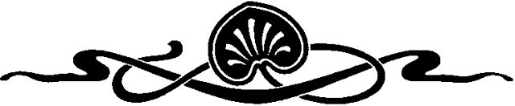
COMPUTER GRAPHICS
Hochiminh city University of Technology
Faculty of Computer Science and Engineering
CHAPTER 05:
Vector in Computer Graphics

Slide 2
OUTLINE
Vector
Dot product
Cross Product
Scalars
Points
Affine Sums
Parametric Form
Line
Plane
Some Example
Representation

Slide 3
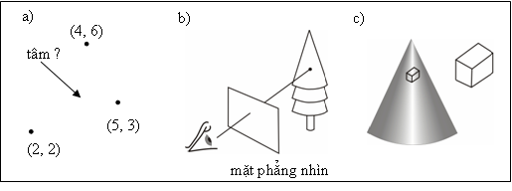
Vector
Why vector important?
Remove Hidden-face.
Normal vector
Three basic elements in geometry: scalar, point, vector

Slide 4
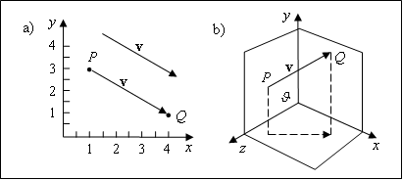
Vector
Physical definition: a vector is a quantity with two attributes: 1)Direction; 2)Magnitude
Examples include: 1)Force; 2)Velocity
Vectors Lack Position: These vectors are identical
Same length and magnitude

Slide 5
Vector
A = (1, 2, 9), B = (4, 6, 3)
AB = (4 – 1, 6 - 2, 3 - 9) = (3, 4, -6)
BA = (1 – 4, 2 – 6, 9 – 3) = (-3, -4, 6)

Slide 6
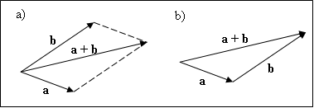
Vector
a = (2, 5, 6), b = (-2, 7, 1)
Addition: a + b = (0, 12, 7)
Scalar-vector multiplication: 6a = (12, 30, 39)
Subtraction: a - b = a + (-b) = (4, -2, 5)

Slide 7
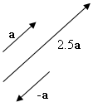
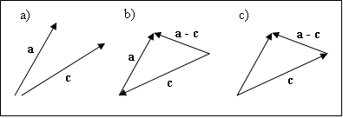
Vector

Slide 8
Vector
Magnitude:
Unit vector:

Slide 9
Dot product
Definition: The dot product d of two n-dimensional vectors v = (v₁, v₂, ..., v_{n}) and w = (w₁, w₂, ..., w_{n}) is denoted as v•w and has the value:
Properties
Symmetry: a•b = b•a
Linearity: (a + c)•b = a•b + c•b
Homogeneity: (sa)•b = s(a•b)
|b|² = b•b

Slide 10
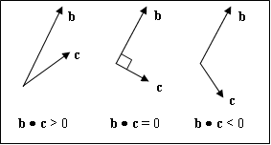
Dot product
The angle between two vectors
b•c = |b||c| cos(θ)

Slide 11
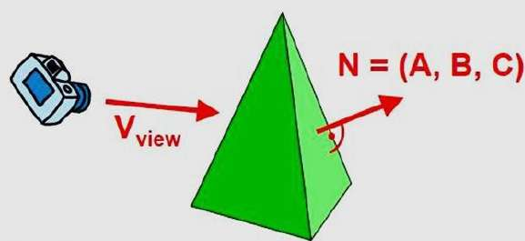
Dot product

Slide 12
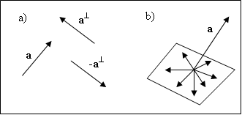
Dot product
The 2D “perp” vector
Suppose a = (ax, ay), then a ⊥ = (-ay, ax) is the counterclockwise perpendicular to a.

Slide 13
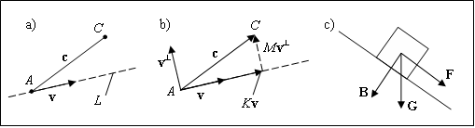
Dot product
Orthogonal Projections and the Distance from a point to a line
c = Kv + Mv⊥ ( K, M = ?)

Slide 14
Dot product
c = Kv + Mv⊥ ( K, M = ?)
(cx, cy) = K(vx, vy) + M(vx⊥, vy⊥ )
cx = K*vx + M*vx⊥
cy = K*vy + M*vy⊥

Slide 15
Dot Product
c = Kv + Mv⊥ ( K, M = ?)
c•v = Kv•v + Mv⊥•v →
c•v⊥ = Kv⊥•v + Mv⊥•v⊥ →

Slide 16
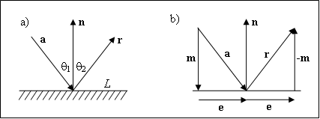
Dot product
Reflection
r = e – m, e = a - m → r = a - 2m
r = a - 2(a • u_{n} )u_{n}

Slide 17
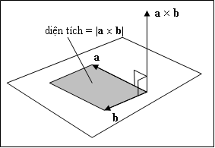
Cross Product
The cross product of two vector is a vector
Only for 3-dimensinal vector
Suppose a = (a_{x}, a_{y}, a_{z}) and b = (b_{x}, b_{y}, b_{z}), then the cross product of a and b is
a × b = (a_{y}b_{z} – a_{z}b_{y})i + (a_{z}b_{x} – a_{x}b_{z})j + (a_{x}b_{y} – a_{y}b_{x})k
|a × b| = |a||b|sin(θ)

Slide 18
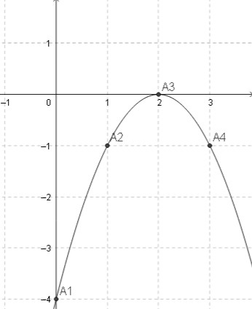
Parametric Form
Explicit
y = -x² + 4x - 4
How to draw
x² + y² = 1

Slide 19
Parametric Form
Parametric form
Ex 1: a straight line passes through A and B. Choose a parametric form that visit A at t = 0, visit B at t = 1.
x(t) = Ax + (Bx - Ax)t
y(t) = Ay + (By - Ay)t
@ t = 1
B (Bx, By)
@ t = 0
A (Ax, Ay)

Slide 20
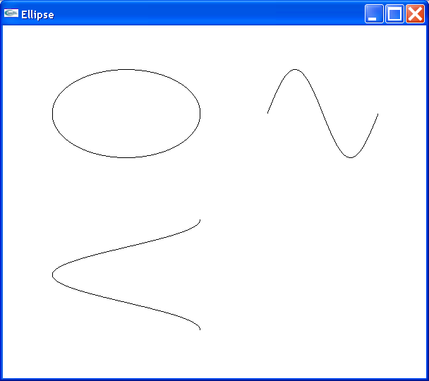
Parametric Form
Parametric form
(x/W)² + (y/H)² = 1
EX 2: Ellipse with radius W and H
x(t) = Wcos(t)
y(t) = Hsin(t)
với ( 0≤ t ≤ 2π )
t=π/2
y
y(t)
H
(x(t), y(t))
H
W
2π
-c
c
x
t
t=π
-H
-W
W
x(t)
π
2π
t

Slide 21
Parametric Form
Draw parametric form curve
a)
t = T
b)
P_{m}
P₂
t = 0
P₁
P(t) = (x(t), y(t))
//draw the curve (x(t), t(t)) using
//the array t[0], ..., t[n-1] of “sample-times”
glBegin(GL_LINE_STRIP);
for(int i=0;i<n;i++)
glVertex2f(x(t[i]), y(t[i]));
glEnd() ;

Slide 22
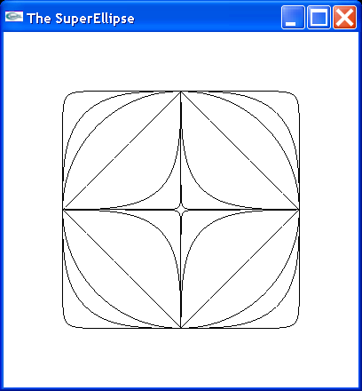
Parametric Form
Superellipse
Implicit form
Parametric form
n = 2m/(2n+1)
n < 1 inward
n > 1 outward
n = 1 square

Slide 23
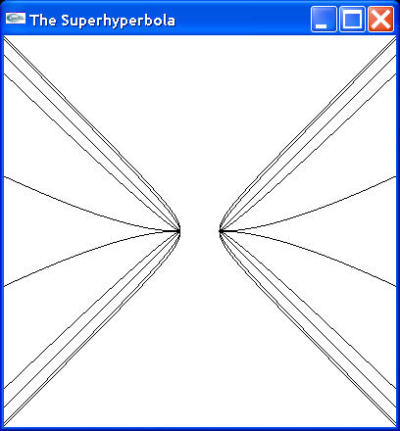
Parametric Form
Superhyperbola
Parametric form
n = 2m/(2n+1)
n < 1 inward
n > 1 outward
n = 1 line

Slide 24
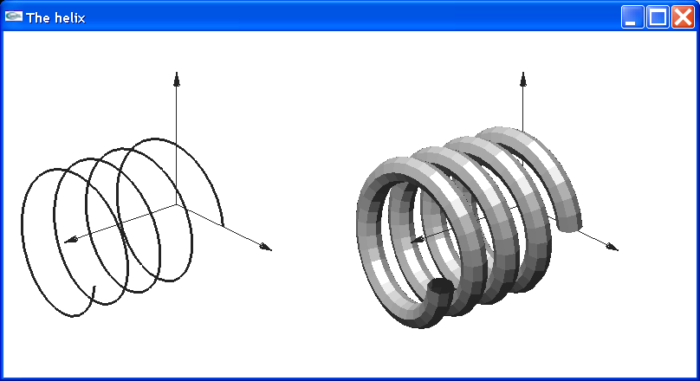
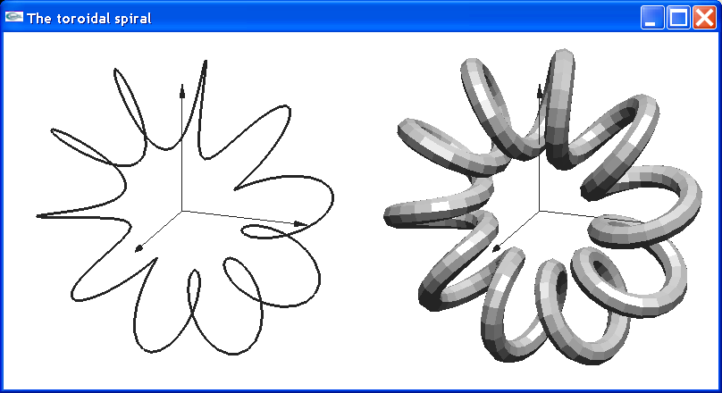
Parametric Form
3D curves
P(t) = (x(t), y(t), z(t))
Helix
x(t) = cos(t)
y(t) = sin(t)
z(t) = bt
Toroidal spiral
x(t) = (asin(ct) + b)cos(t),
y(t) = (asin(ct) + b)sin(t),
z(t) = acos(ct)

Slide 25
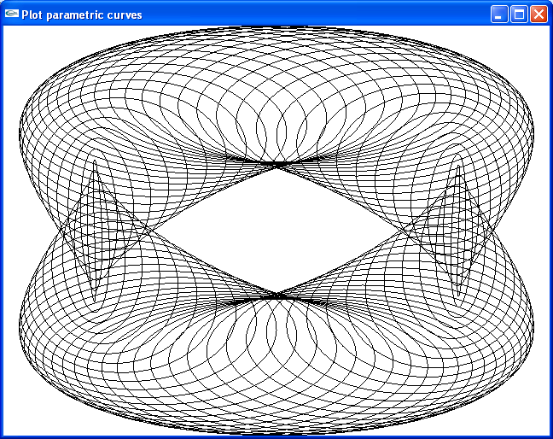
Parametric Form
x = cos(t) - cos(80*t)*sin(t);
y = 2.0*sin(t) - sin(80*t);

Slide 26
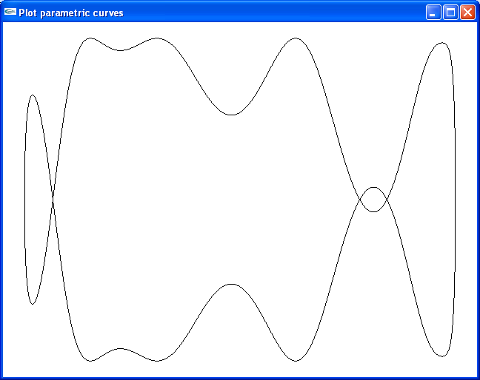
Parametric Form
x = cos(t);
y = sin(t + sin(5.0*t));

Slide 27
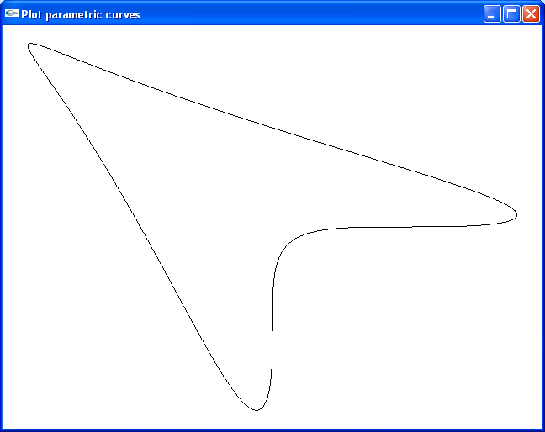
Parametric Form
x = sin(t+sin(t));
y = cos(t + cos(t));

Slide 28
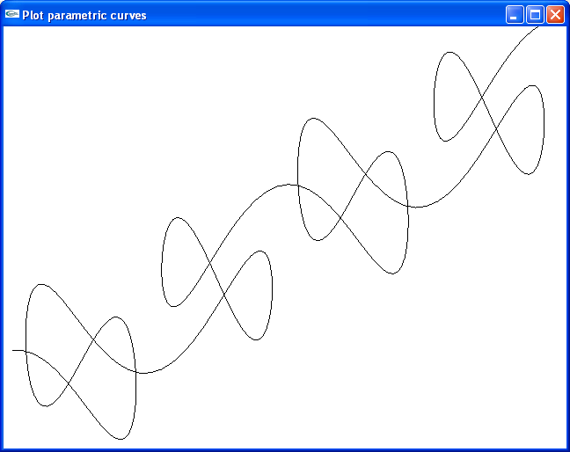
Parametric Form
x = t + 2.0*sin(2.0*t);
y = t + 2.0*cos(5.0*t);

Slide 29
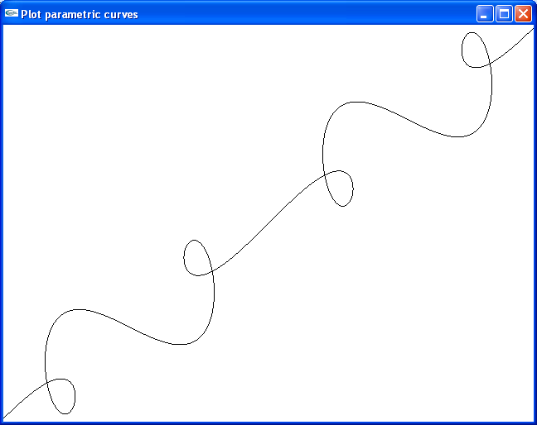
Parametric Form
x = t + sin(2.0*t);
y = t + sin(3.0*t);

Slide 30
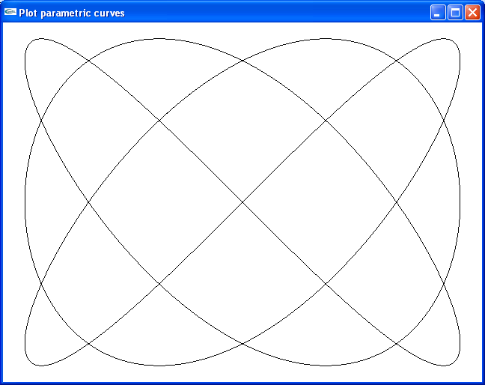
Parametric Form
x = sin(3.0*t);
y = sin(4.0*t);

Slide 31

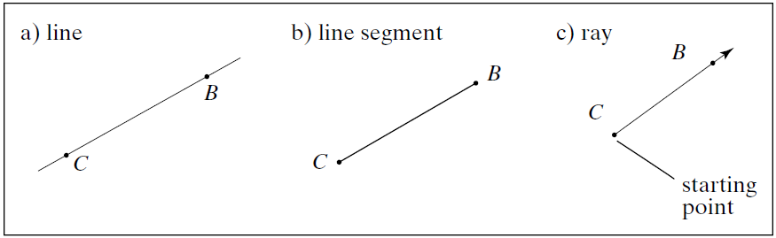
Line
y = 5x + 3
(1)
(2)
(3)
x = 1

Slide 32
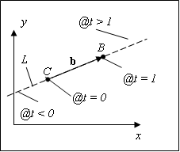
Line
Line, line segment, ray
Parametric form
L(t) = C + bt
Line segment, 0 ≤ t ≤ 1
Ray, 0 ≤ t ≤ ∞ Line, -∞ ≤ t ≤ ∞

Slide 33

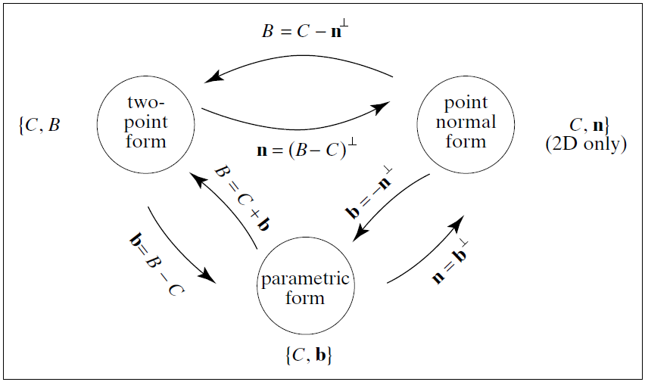
Line
Point-normal form: n•(R - C) = 0
Conversion

Slide 34
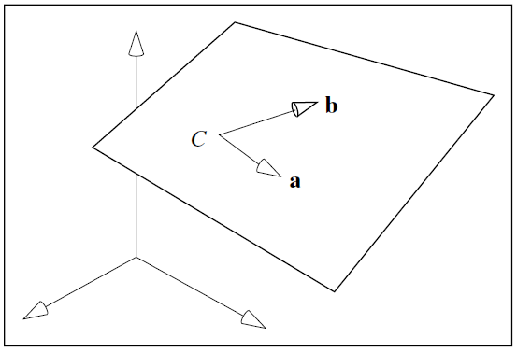
Plane
Parametric form:
P(s, t) = C + sa + tb
Point-normal form:
n•(R - C) = 0
n = a×b

Slide 35
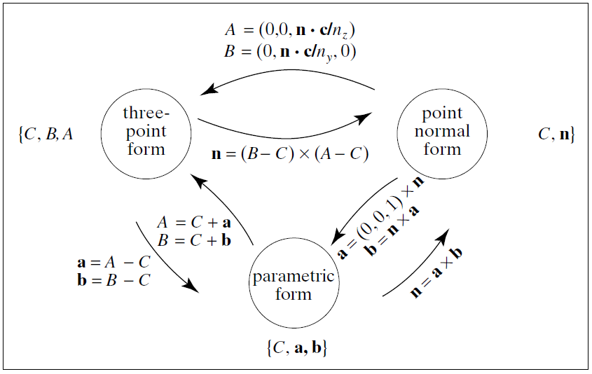
Plane
Conversion

Slide 36
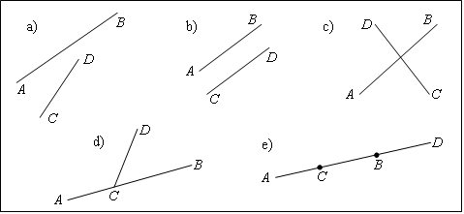
Some Examples
Intersection of two line segment
AB(t) = A + bt ; CD(u) = C + du
Find t and u such as A + bt = C + du
bt = c + du với c = C - A
d⊥ • bt = d⊥ • c
d⊥ • b ≠ 0.
d⊥ • b = 0

Slide 37
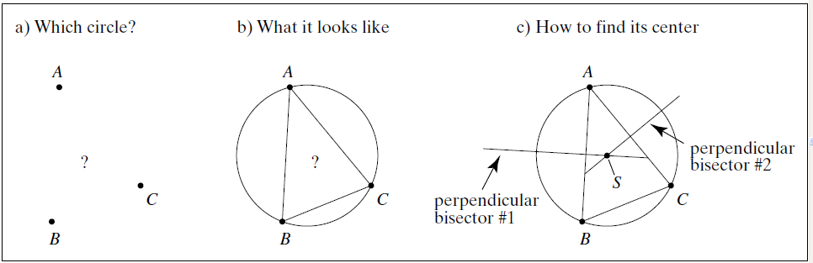
Some Examples
The Circle through 3 points
Perpendicular bisector
a = B - A; b = C - B; c = A - C;
Perp. bisector AB: A + a/2 + a⊥t ; AC: A - c/2 + c⊥u
a⊥t = b/2 + c⊥u →

Slide 38
Representation
y
P
v
b
b
a
j
j
0
i
x
0
i
x
a
v = a + b = 2.1i + 1.2j → v = (2.1, 1.2)
P = O + OP = O + a + b = O + 3.9i + 3.7j → P = (3.9, 3.7)

Slide 39
Representation
x
x
v
i
i
P
j
j
y
y
v = 1.6i + 2.7j → v = (1.6, 2.7)
P = (1.9, 3.6)

Slide 40
Representation
Frames
Frame determined by (P₀, v₁, v₂, v₃)
Within this frame, every vector can be written as
v=α₁v₁+ α₂v₂ +….+α_{n}v_{n}
Every point can be written as
P = P₀ + β₁v₁+ β₂v₂ +….+β_{n}v_{n}

Slide 41
Representation
Confusing Points and Vector
y
v
P
j
0
i
x
v = (2, 1); P = (2, 1)

Slide 42
Representation
Confusing Points and Vector
y
v = 2*i + 1*j =
= 2*i + 1*j + 0*O
= (2, 1, 0)
v
P = 2*i + 1*j + O
= 2*i + 1*j + 1*O
= (2, 1, 1)
P
j
0
i
x

Slide 43
Representation
A Single Representation
If we define 0•P = 0 and 1•P =P then we can write
v=α₁v₁+ α₂v₂ +α₃v₃ = [α₁ α₂ α₃ 0 ] [v₁ v₂ v₃ P₀] ^{T}
P = P₀ + β₁v₁+ β₂v₂ +β₃v₃= [β₁ β₂ β₃ 1 ] [v₁ v₂ v₃ P₀] ^{T}
Thus we obtain the four-dimensional homogeneous coordinate representation
v = [α₁ α₂ α₃ 0 ] ^{T}
p = [β₁ β₂ β₃ 1 ] ^{T}

Slide 44
Representation
Homogeneous Coordinates
The homogeneous coordinates form for a three dimensional point [x y z] is given as
p =[x’ y’ z’ w] ^{T} =[wx wy wz w] ^{T}
We return to a three dimensional point (for w≠0) by
x←x’/w
y←y’/w
z←z’/w
If w=0, the representation is that of a vector
Note that homogeneous coordinates replaces points in three dimensions by lines through the origin in four dimensions
For w=1, the representation of a point is [x y z 1]

Slide 45
Representation
Change of Coordinate Systems
Consider two representations of a the same vector with respect to two different bases. The representations are
a=[α₁ α₂ α₃ ]
b=[β₁ β₂ β₃]
where
v=α₁v₁+ α₂v₂ +α₃v₃ = [α₁ α₂ α₃] [v₁ v₂ v₃] ^{T}
=β₁u₁+ β₂u₂ +β₃u₃ = [β₁ β₂ β₃] [u₁ u₂ u₃] ^{T}

Slide 46
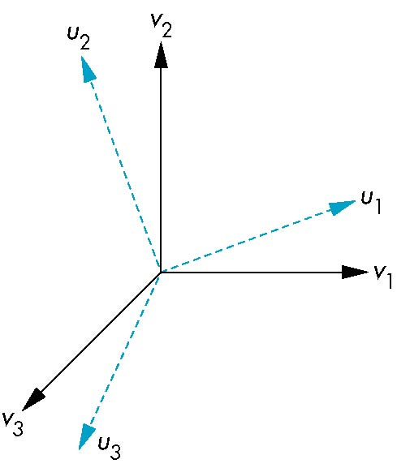
Representation
Change of Coordinate Systems
Each of the basis vectors, u1,u2, u3, are vectors that can be represented in terms of the first basis
v
u₁ = γ₁₁v₁+γ₁₂v₂+γ₁₃v₃
u₂ = γ₂₁v₁+γ₂₂v₂+γ₂₃v₃
u₃ = γ₃₁v₁+γ₃₂v₂+γ₃₃v₃

Slide 47
Representation
Change of Coordinate Systems
The coefficients define a 3 x 3 matrix
and the bases can be related by
M =
a=M^{T}b

Slide 48
Representation
Change of Coordinate Systems
u2
w
v2
v1
u1

Slide 49
Representation
Change of Coordinate Systems
w
v2
u2
u1
v1

Slide 50
Representation
Change of Frames
We can apply a similar process in homogeneous coordinates to the representations of both points and vectors
Any point or vector can be represented in either frame
We can represent Q₀, u₁, u₂, u₃ in terms of P₀, v₁, v₂, v₃
u₂
u₁
v₂
Consider two frames:
(P₀, v₁, v₂, v₃)
(Q₀, u₁, u₂, u₃)
Q₀
P₀
v₁
u₃
v₃

Slide 51
Representation
Change of Frames
Extending what we did with change of bases
u₁ = γ₁₁v₁+γ₁₂v₂+γ₁₃v₃
u₂ = γ₂₁v₁+γ₂₂v₂+γ₂₃v₃
u₃ = γ₃₁v₁+γ₃₂v₂+γ₃₃v₃
Q₀ = γ₄₁v₁+γ₄₂v₂+γ₄₃v₃ +γ₄₄P₀
defining a 4 x 4 matrix
M =

Slide 52
Representation
Change of Frames
Within the two frames any point or vector has a representation of the same form
a=[α₁ α₂ α₃ α₄ ] in the first frame
b=[β₁ β₂ β₃ β₄ ] in the second frame
where α₄ = β₄ = 1 for points and α₄ = β₄ = 0 for vectors and
The matrix M is 4 x 4 and specifies an affine transformation in homogeneous coordinates
a=M^{T}b

